Slide 1
Multiclass Classification of 2D Geometric Shapes
Sam Strickler and Izabella Kocsis

Slide 2
Project Overview
Goal: Develop a convolutional neural network (CNN) in PyTorch to classify 17 types of 2D geometric shapes based on spatial properties (not color).
Motivation: Shape recognition is a foundational task in computer vision, supporting more advanced applications like object detection, autonomous navigation, and visual pattern analysis.
Dataset: Used the 2D Geometric Shapes dataset from Kaggle, which includes synthetic images of circles, triangles, stars, and polygons.
Approach: We built an end-to-end image classification pipeline that resizes input images, feeds them through a CNN, and predicts shape categories.
Outcome: Achieved accurate shape classification by training on a subset of the dataset, demonstrating the CNN’s ability to learn visual features from clean, structured data.

Slide 3


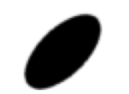



Dataset Overview
Our model is trained on a Kaggle dataset called 2D_Geometric_Shapes_Dataset
Number of Images per Shape: 50000
Total Images: 850,000 (50000 images * 17 shapes)
Image Size: 224x224 pixels
Image Format: PNG
Each image contains a single shape, randomly positioned and rotated within the image. The background is white, and the shape color is randomly chosen from a predefined set of colors.
(https://www.kaggle.com/datasets/khalidboussaroual/2d-geometric-shapes-17-shapes/data)

Slide 4


Slide 5
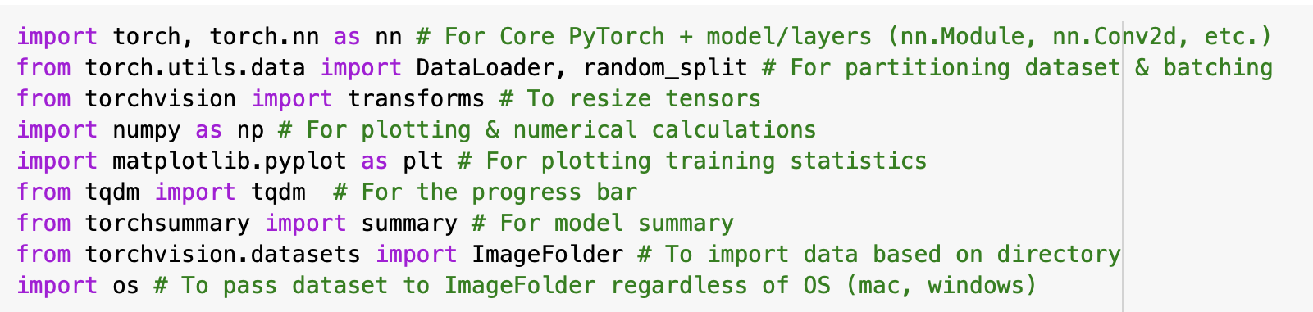
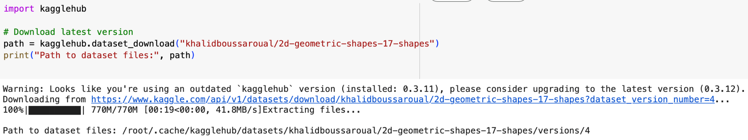
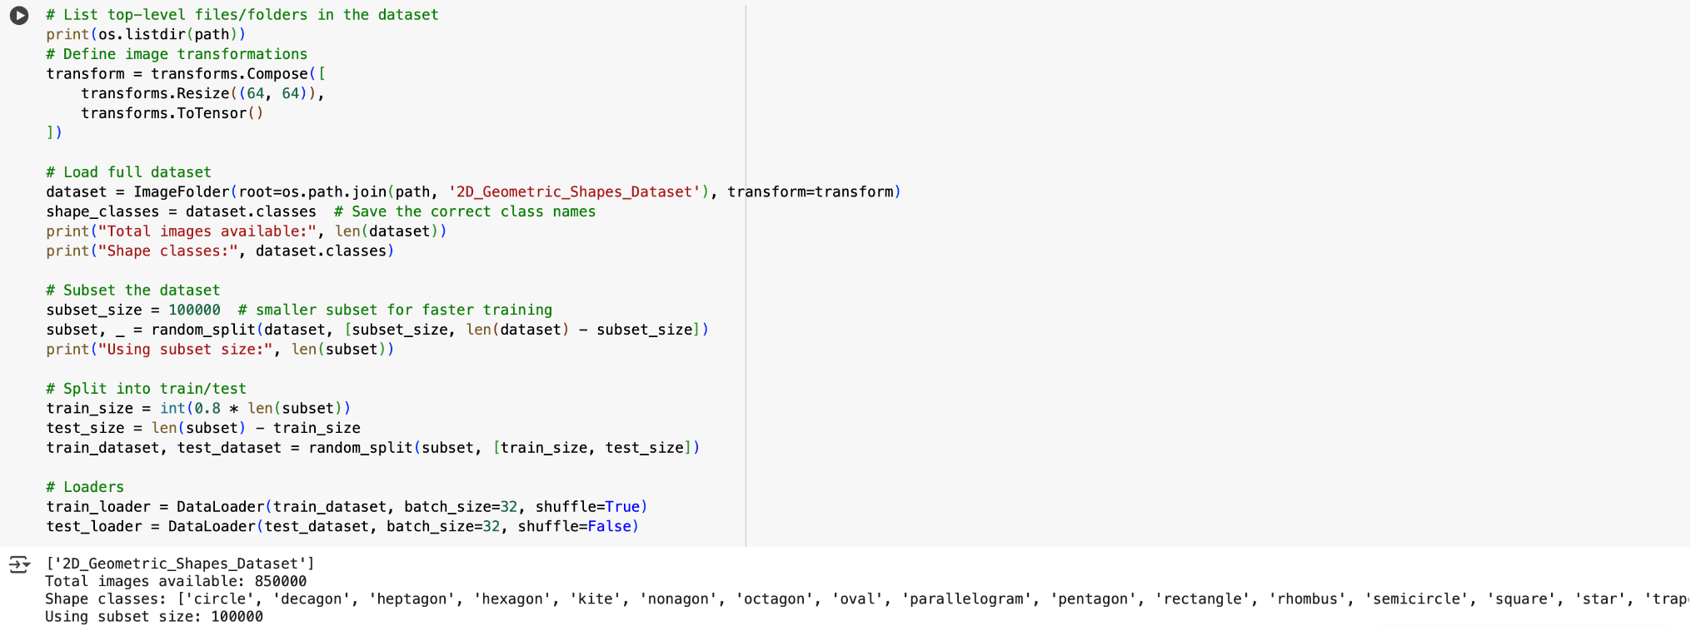
Importing Dataset & Initializing Data Variables
Notes:
Modules & Uses:
torch, torch.nn as nn - Core PyTorch + model/layers (nn.Module, nn.Conv2d, etc.)

Slide 6
Image Classification: The Power of the CNN
What is a CNN Model?
A Convolutional Neural Network (CNN) is a type of deep learning model designed to process grid-like data, usually images.
CNNs are specialized to recognize spatial patterns like edges, shapes, and textures.
Instead of connecting every input pixel to every neuron (like a traditional fully connected network), CNNs use filters/kernels to scan small patches of an image at a time, learning specific patterns like lines, corners, etc.
Why CNNs are Powerful
They share weights across space, massively reducing the number of parameters.
They can recognize objects even if they move around the image. (Something we will test!)
They learn hierarchies of features: low-level features (edges) → mid-level (textures) → high-level (objects).
Basic Structure of a CNN
Convolutional Layers: Detect patterns with filters/kernels.
Activation Functions: Apply non-linearity (ReLU).
Pooling Layers: Downsample feature maps to reduce size and computation (Max Pooling).
Fully Connected Layers: Combine extracted features to make final predictions.

Slide 7
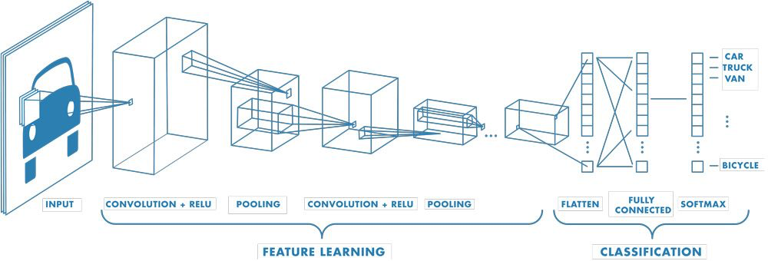

Slide 8
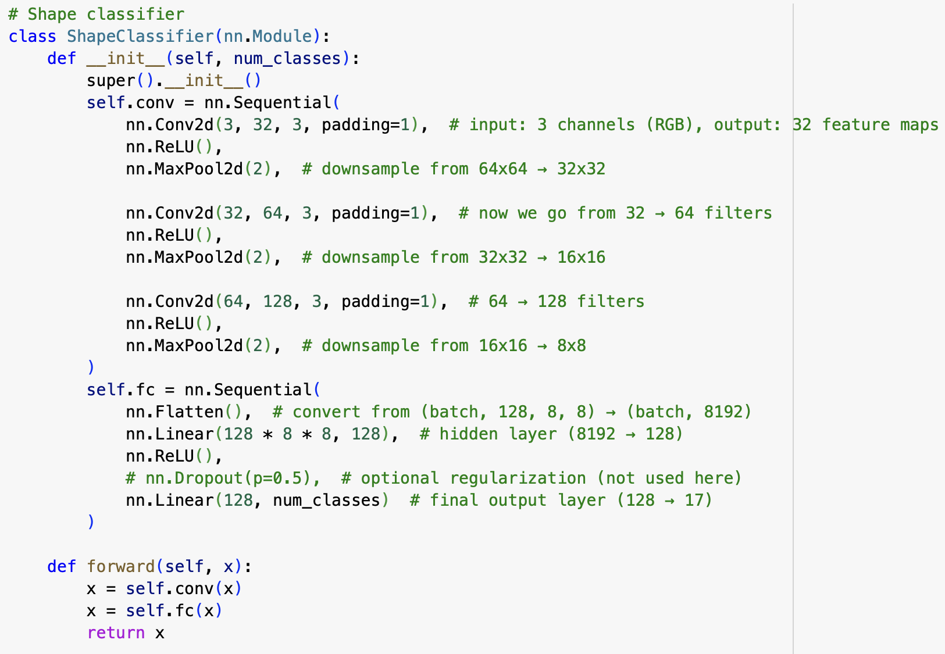
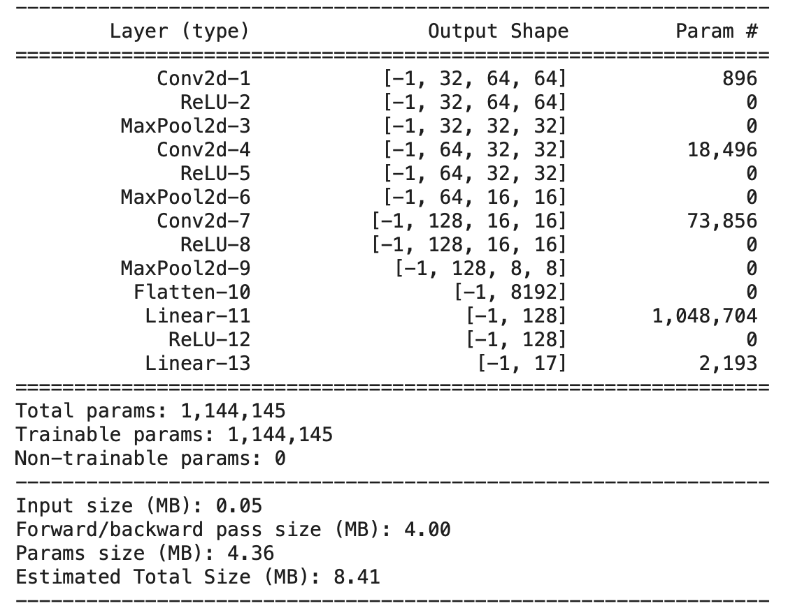
Building the CNN Architecture
The model takes in a 64×64 RGB image and passes it through three convolutional layers that progressively learn to detect patterns related to shape. After flattening this into a big feature vector, it passes through a small neural network to predict which of the 17 shapes the image belongs to.
Note: We use a kernel size of 3×3, a stride of 1, and a padding of 1 to preserve the spatial dimensions of the feature maps across convolutional layers

Slide 9

Optimizer and Loss
The model uses Adam (Adaptive Moment Estimation) with a default learning rate of 0.001, as it works well with image classification tasks by adaptive learning rates per parameter, handling sparse gradients, and converging faster than traditional SGD.
The model uses cross-entropy loss commonly used for classification (In PyTorch, the function includes a built-in softmax step, so explicit application is unnecessary).
Our CNN outputs raw scores called logits for each of the 17 classes. These scores are passed through the softmax function. The softmax function then transforms the logits into probabilities between 0 and 1. Ensures the values add up to 1, forming a valid probability distribution.
Cross-entropy loss measures the difference between the predicted probability distribution (softmax) and the true label distribution, represented by a one-hot distribution. A lower cross-entropy value means predictions are closer to the true class.

Slide 10
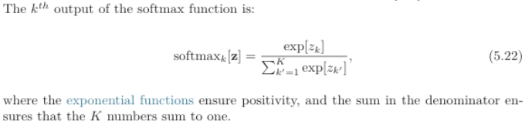

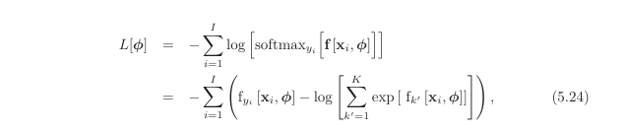
Softmax And Multiclass Cross-Entropy Loss
The softmax function converts the model’s raw output scores (logits) into probabilities for each shape class. It ensures the outputs sum to 1, allowing the model to make a clear prediction based on the highest probability.
The cross-entropy loss function measures how well the predicted probability distribution matches the true label. It penalizes confident but incorrect predictions more heavily, helping the model to improve its accuracy over time.
(Figures from Prince, 2024, p. 68-69)

Slide 11
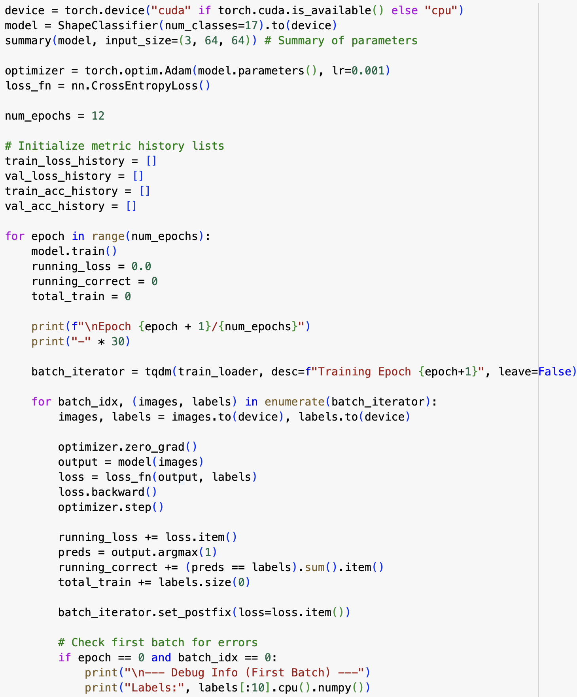
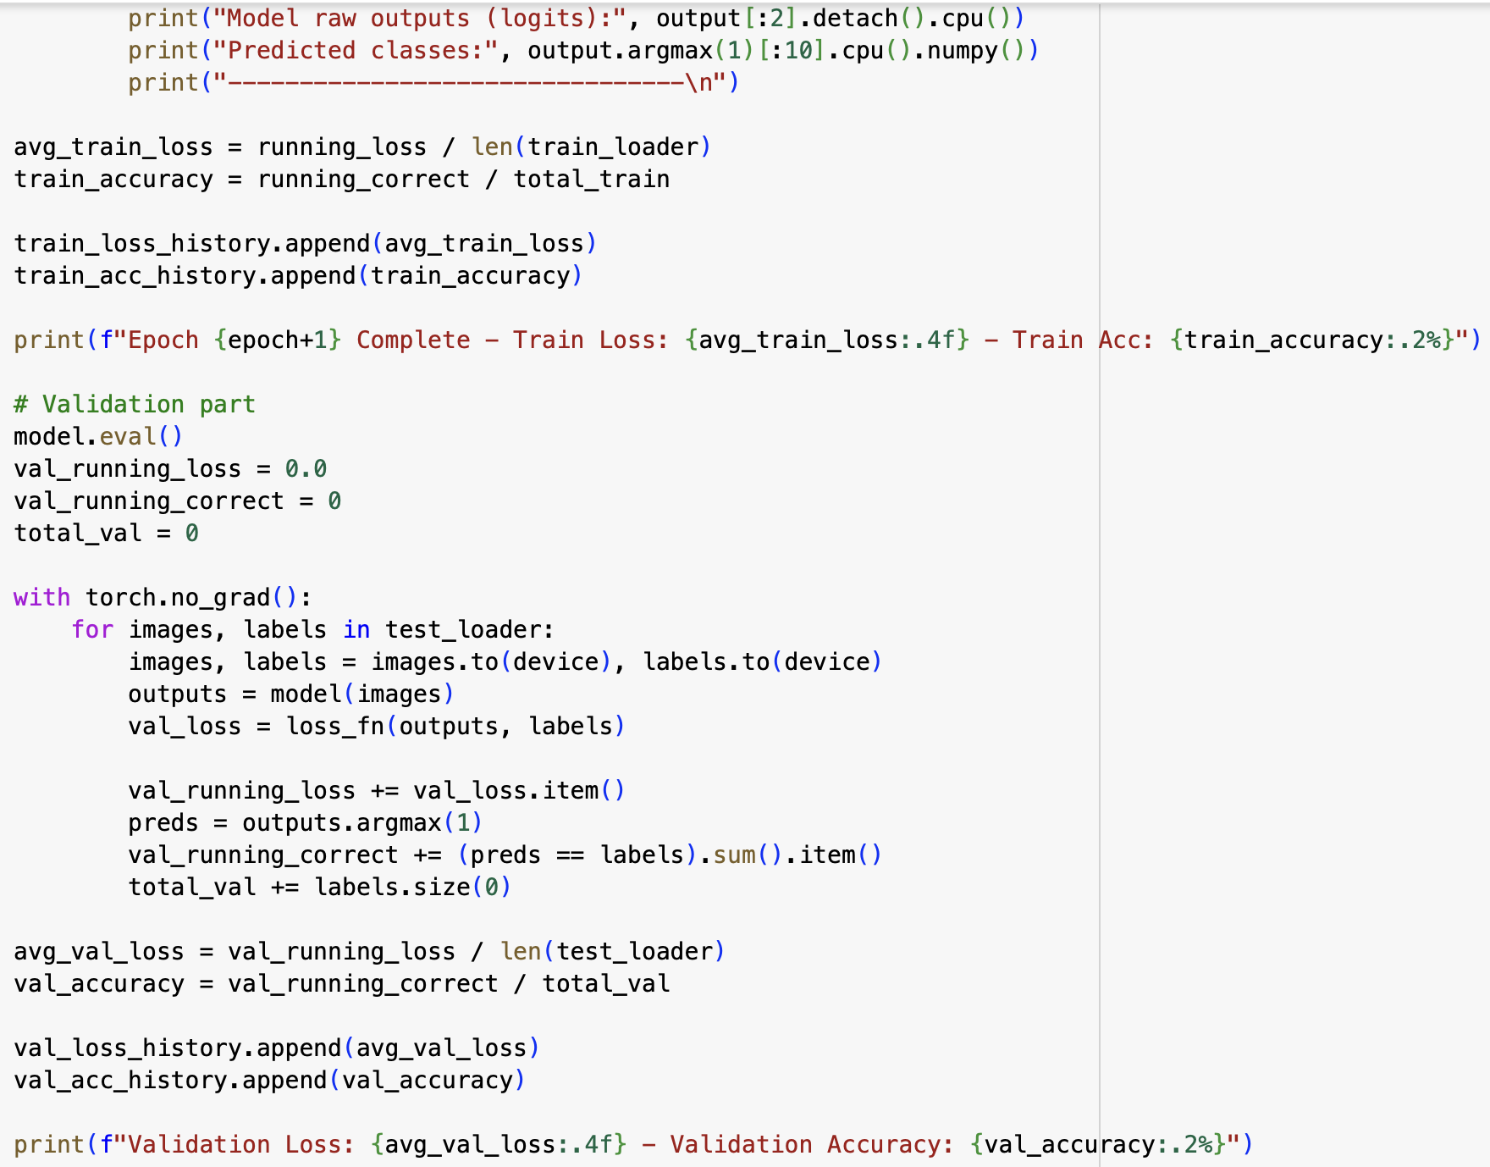
Training Process & Metrics (1/2)

Slide 12
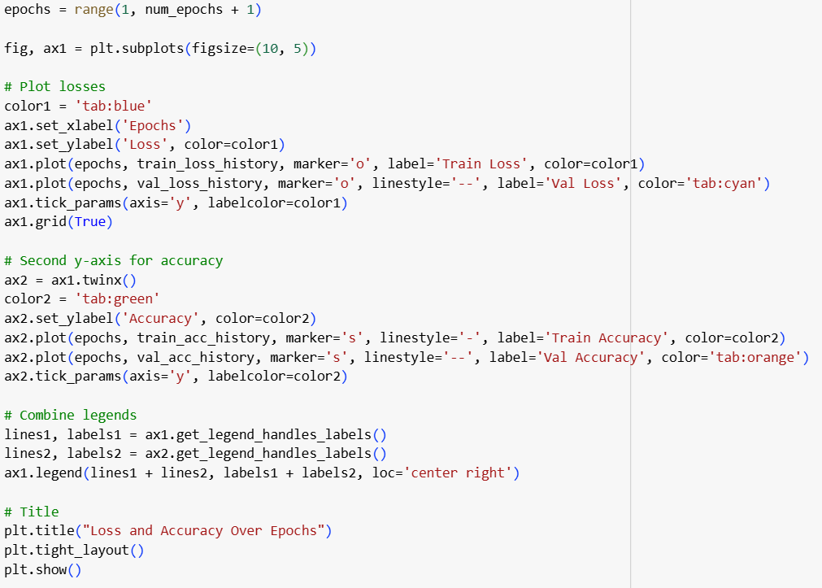
Training Process & Metrics (2/2)
Forward Pass: Input images are passed through the network and obtain the predicted values (classifications).
Compute Loss: Calculate the error between predicted scores and true values – higher error means higher loss..
Backward Pass (Backpropagation): Computes the gradient of the loss with respect to each parameter to determine adjustments that help the model learn.
Update: Adam adjusts weights and biases based on the gradients and each parameter’s learning history.
Evaluation: Keeping track of the loss and accuracy at each epoch. Accuracy is the percentage of shapes the model classified correctly out of the total inputs.

Slide 13
Tuning the CNN: Evaluation of Training/Testing Loss and Accuracy

Slide 14
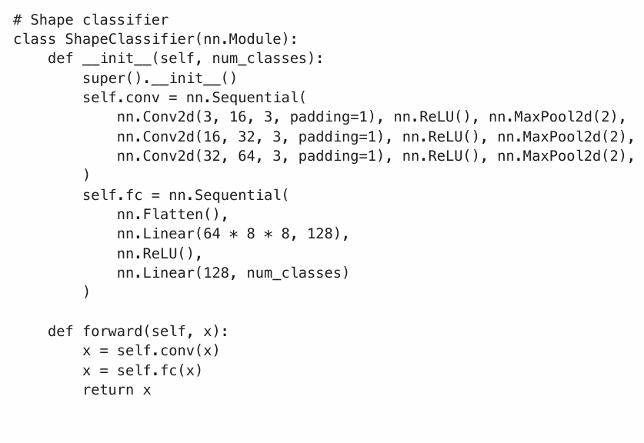

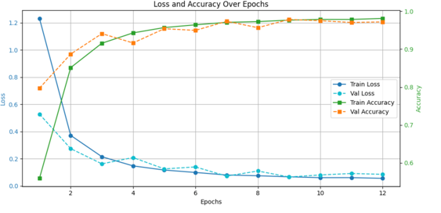
Initial Prototype
16 to 32 to 64 filters
Trained on 100,000 images
No dropout
Notes:
Stride is default = 1, padding = 1 keeps spacial dimensions, if padding was “valid’ or =0 would have reduced dimensions, 100,000, batch size = 32 (test/train)

Slide 15
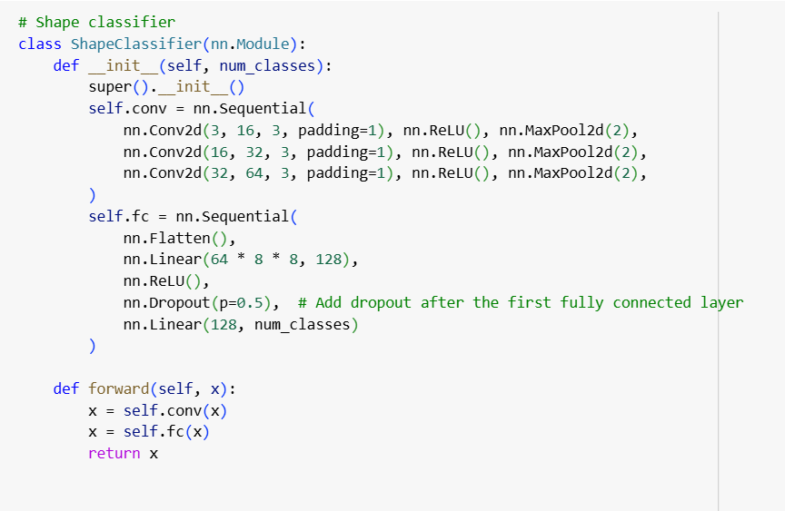
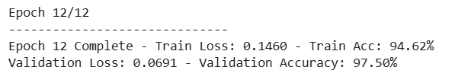
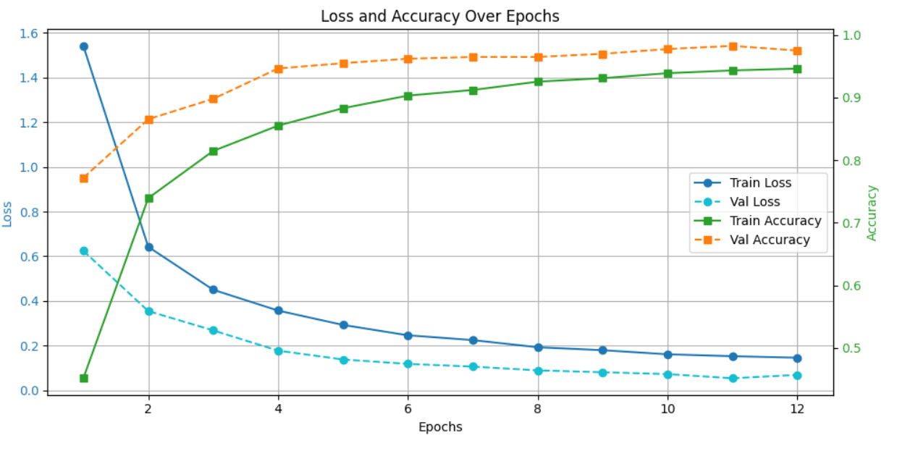
Adding Dropout (p=0.5)
16 to 32 to 64 filters
Trained on 100,000 images
Includes dropout

Slide 16
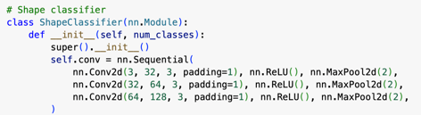
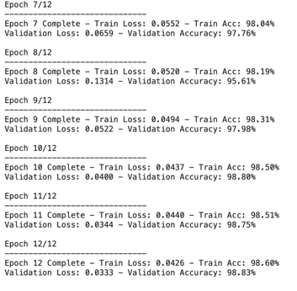
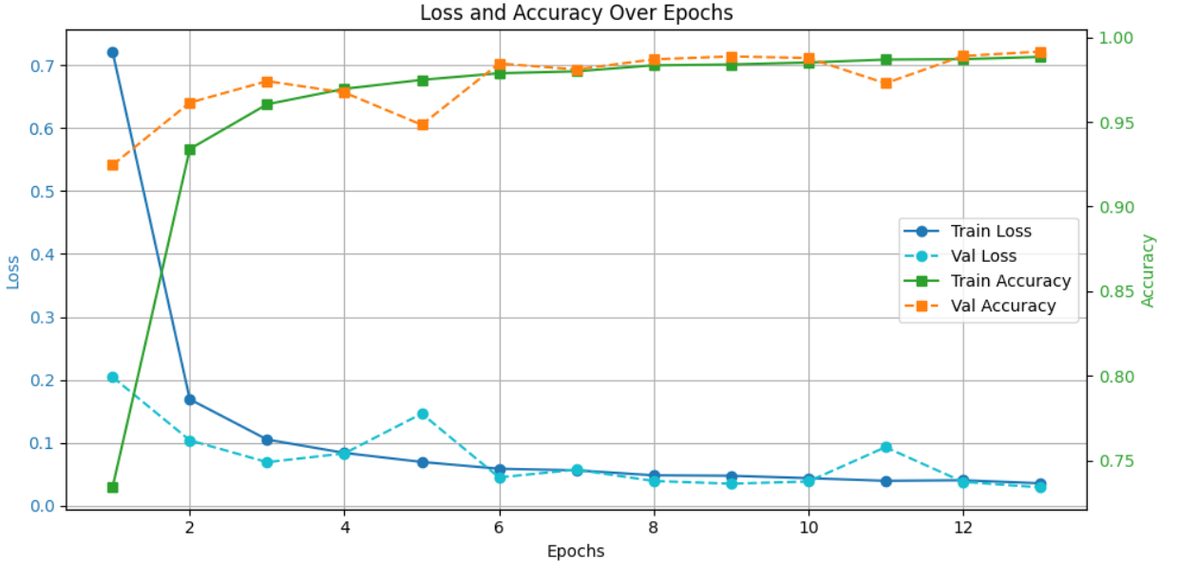
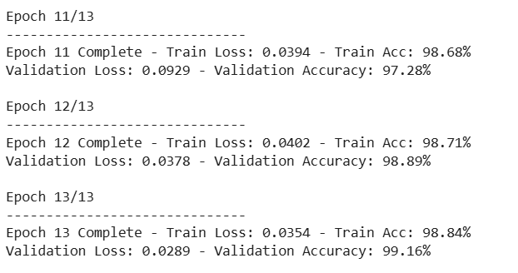
Testing Various Number of Filters
1)
2)
Data partition of 150,000 (12 Epochs)
Data partition of 200,000 (13 epochs)

Slide 17
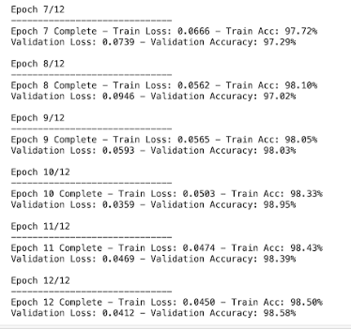
L2 Regularization
L2 regularization or weight decay is used to prevent overfitting by adding a penalty to the loss function based on the magnitude of the weight.
Set weight_decay = 1e^(-4) in optimizer.
32 to 64 to 128 filters
Trained on 150,000 images
No dropout
Added L2 Regularization

Slide 18
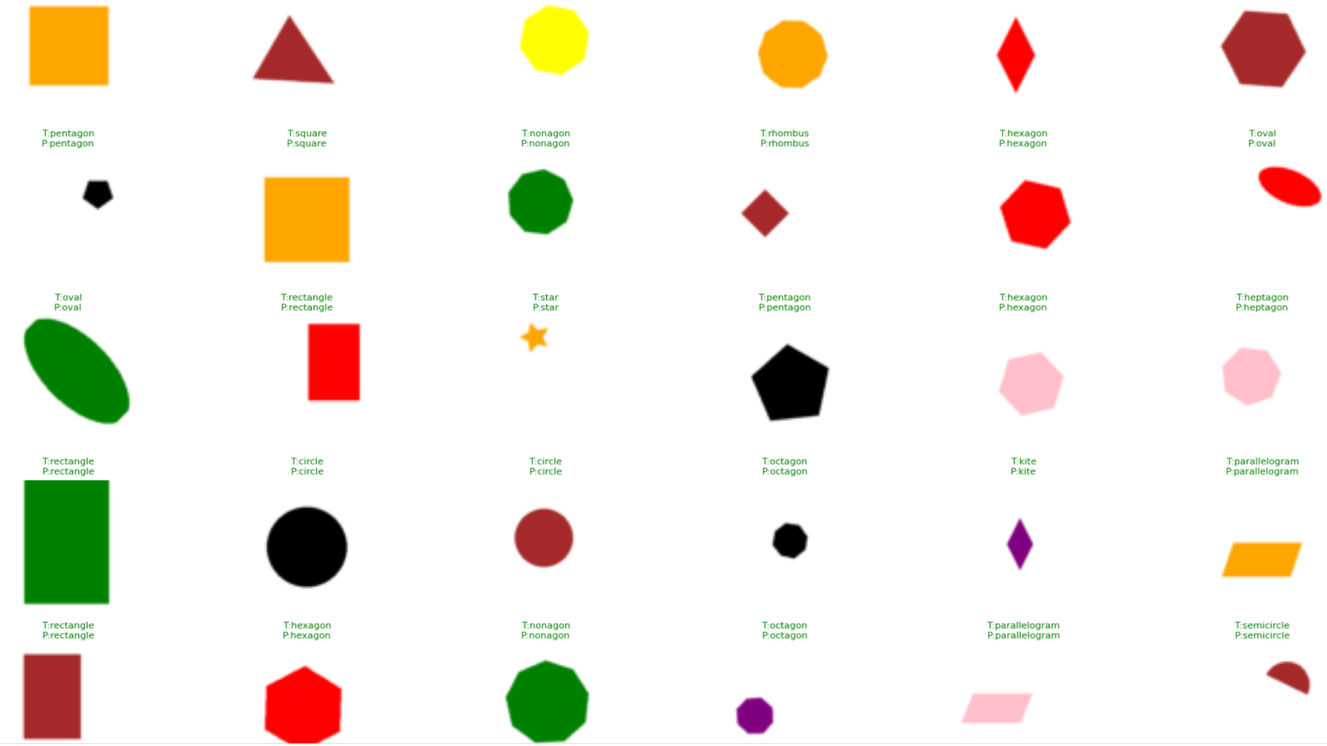
Let’s See Some Shapes! :)

Slide 19
Conclusions
We developed a convolutional neural network (CNN) in PyTorch to classify 17 types of 2D geometric shapes using a synthetic Kaggle dataset.
The model consisted of three convolutional layers with increasing filter sizes (32 → 64 → 128), followed by two fully connected layers to produce class predictions.
We used 3×3 kernels, stride 1, and padding 1 to preserve spatial dimensions, and applied max pooling to gradually reduce feature map size.
The model successfully learned to recognize shapes based on structure and edge patterns, while ignoring color.
Strong validation accuracy and visual prediction results displayed the model’s effectiveness

Slide 20
References
Prince, S. J. D. (2024). Understanding deep learning. Retrieved from https://udlbook.github.io/udlbook/
Krizhevsky, A., Sutskever, I., & Hinton, G. E. ImageNet classification with deep convolutional neural networks. Advances in neural information processing systems, 2012.
He, K., Zhang, X., Ren, S., & Sun, J. Deep residual learning for image recognition. Proceedings of the IEEE conference on computer vision and pattern recognition, 2015.

